Slide 1
A linear modelling exploration of AFL scores
Trent Henderson | 20 May 2021
OLET5608

Slide 2
Structure of the talk
Motivation for the current analysis
Available data and reputability of sources
Analytical approach and appropriateness of linear modelling
Results and model comparisons
Implications for AFL teams and limitations/remediations for future analysis

Slide 3
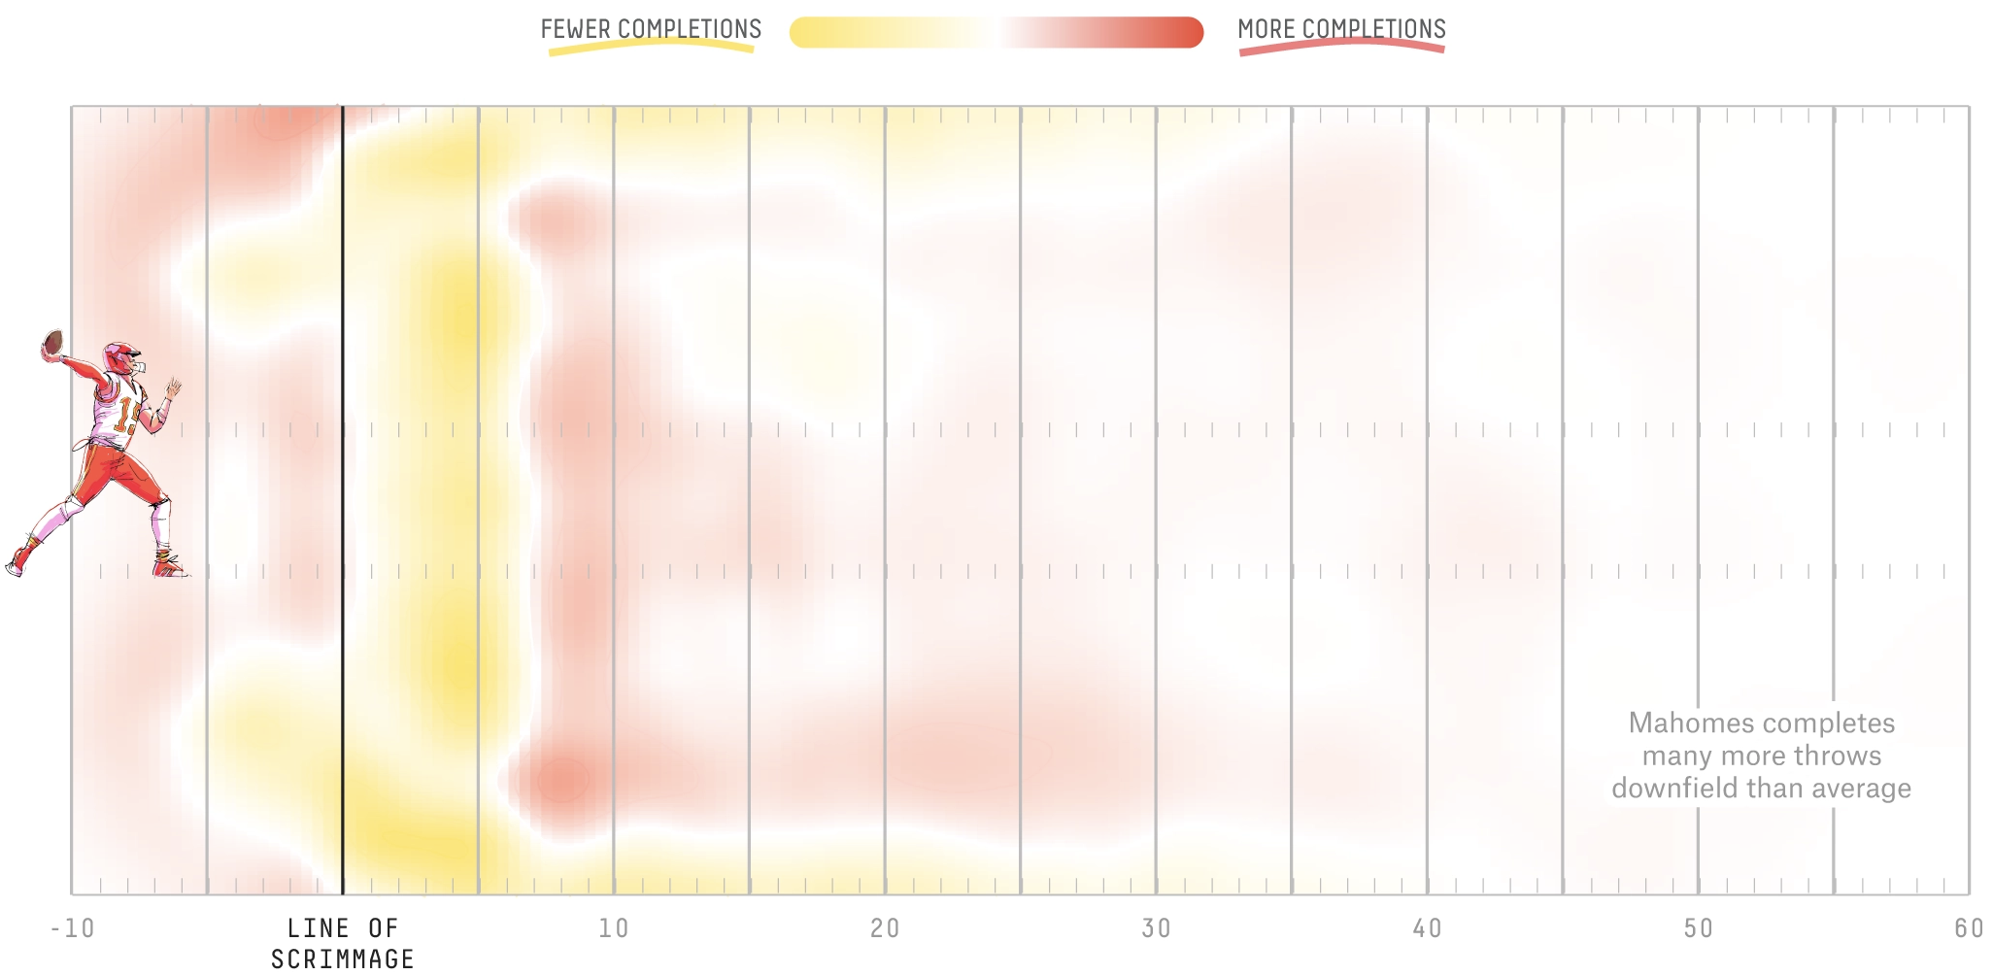
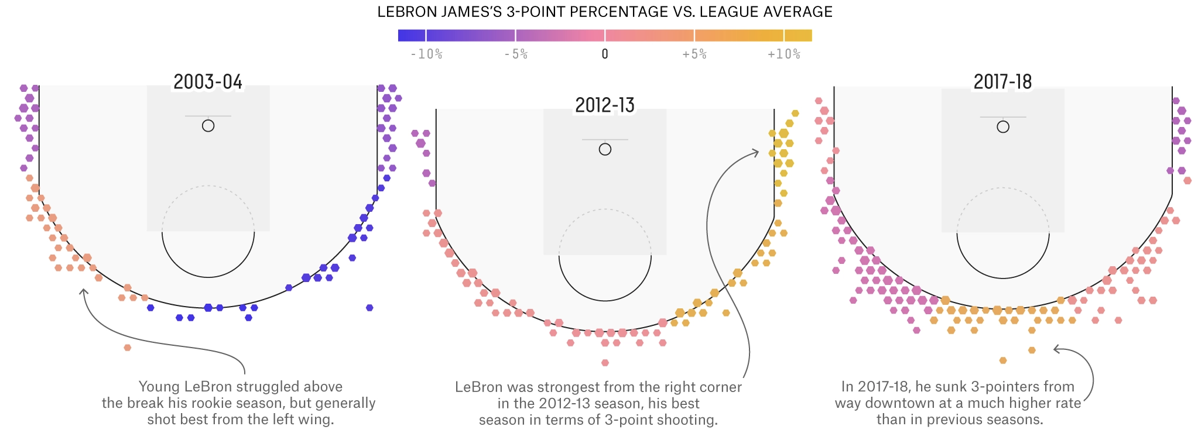
AFL is a highly popular sport with a lack of rigour
Annual memberships for some clubs exceed 100,000
Weekly match attendance is consistently in tens of thousands
Multiple “analysis” talk shows exist for AFL but mostly focus on discussion of high-level numbers
Sophisticated analysis of sport exists overseas - can this be brought to Australia?
Some FiveThirtyEight examples

Slide 4
Open-source work has made data readily available
Data sources
fitzRoy R package
API that automatically webscrapes player-match-level statistics from a range of official and unofficial sources
N = 5,652 (2005-2019)
Variables retained
Total scores, marks, handballs, hit outs, tackles, rebounds, inside 50s, clearances, clangers (unforced errors), free kicks for, contested possessions, contested marks, marks inside 50
Research Question: Which gameplay attributes are predictors of scores in AFL matches?

Slide 5
A robust linear modelling workflow was used
Data extraction from API
Data cleaning, aggregation, and sense checks
Exploratory data analysis and visualisation
Linear model fitting
Final model outputs, comparative analysis, and data visualisation
Assumption testing

Slide 6
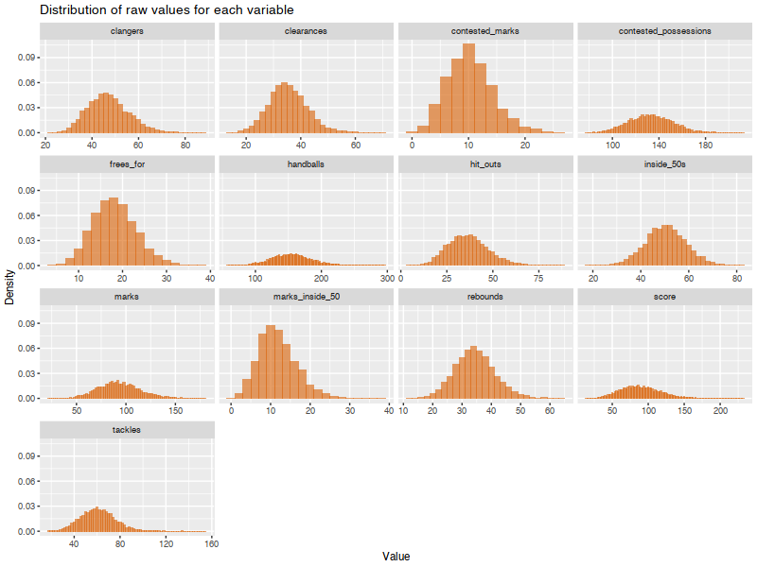
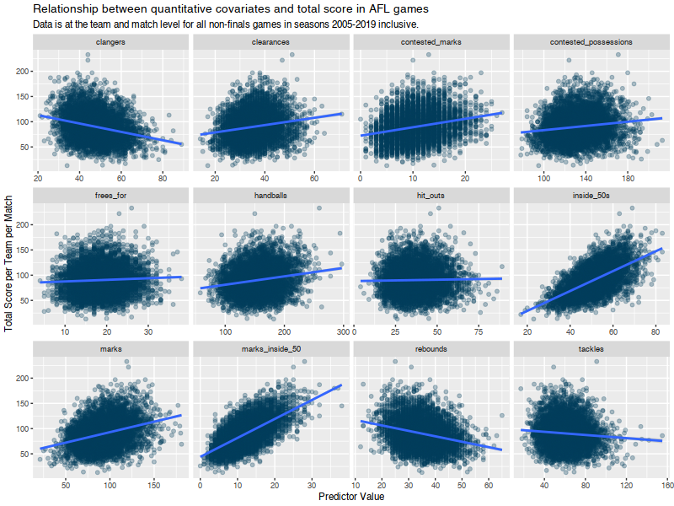
The data was visualized after initial processing

Slide 7
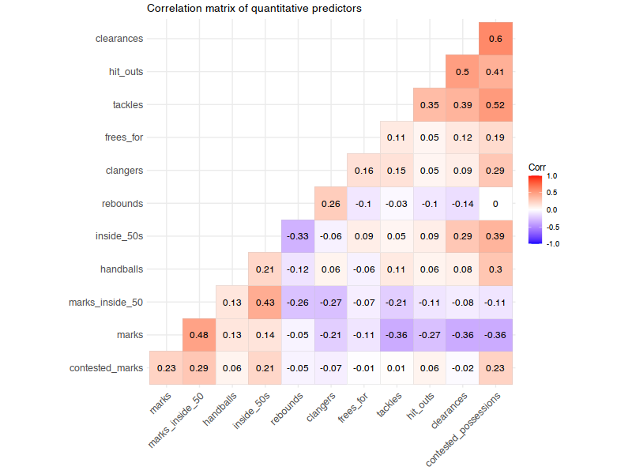
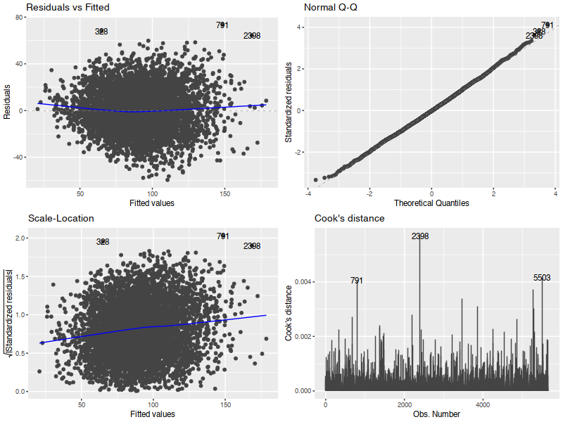
Core linear modelling assumptions were tested

Slide 8
Core linear modelling assumptions were tested
Datapoints are independent
No issue with normality of residuals (Q-Q plot)
Multicollinearity is not an issue
Confirmed using VIF test
No identified outliers
All residuals within Bonferroni-corrected studentized residual critical value
All within Cook’s distance bounds
Slight quadratic shape to the residuals vs fitted plot indicates a potential non-linearity
Non-horizontal line in the scale-location plot indicates heteroscedasticity
Confirmed by statistically significant Breush-Pagan test
Five models were fit as a response to the identified issues:
OLS
OLS with quadratic terms
Weighted OLS
OLS with square-root-transformed response
OLS with log-transformed response
None of the corrections in Models 2, 3, 4, or 5 fixed the observed issues and actually created additional issues for previously acceptable assumptions

Slide 9
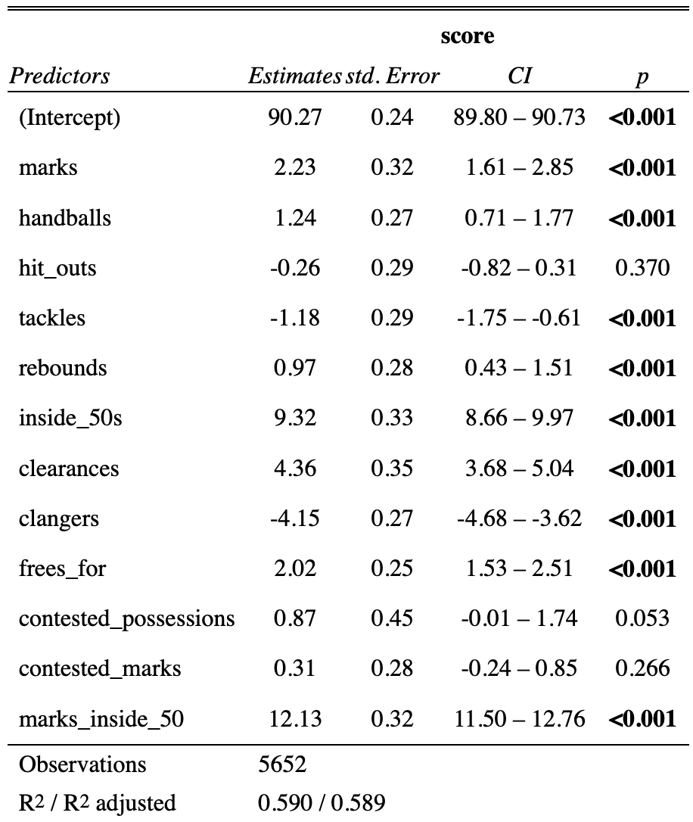
Robust standard error estimators were used
The sandwich package in R provides access to heteroscedastic-robust variance-covariance matrices that do not assume constant variance, defined by:
(X`X)⁻¹X`ΩX (X`X)⁻¹
^{Where:} Ω = σ²I_{n}
Robust estimators drive p-values away from zero, weaken test statistics and increase SEs
All available Ω parameters returned similar estimates so the default HC3 recommended by the authors was used

Slide 10
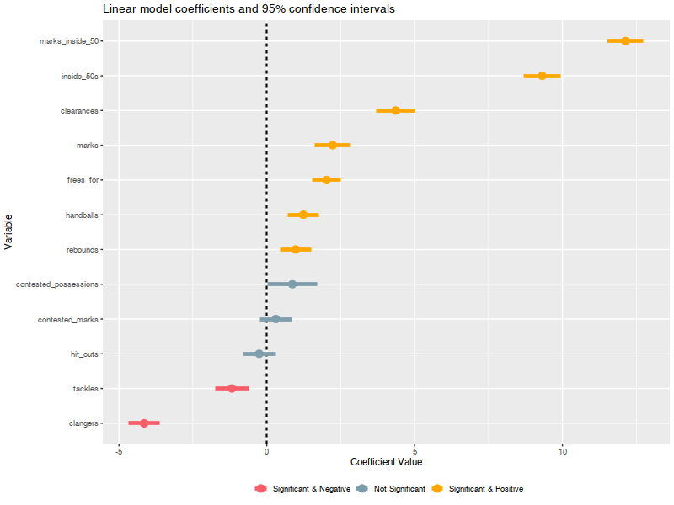
Most of the game metrics could predict total score
Hit outs, contested marks, and contested possessions did not significantly predict scores
Prior to robust estimators, contested possessions was significant
Increases in tackles and unforced errors (clangers) is associated with decreases in total score
The positive coefficient of clearances is surprising given its defensive attribution
The strong positive coefficient for marks inside 50 makes sense given that these lead to controlled “set shot” attempts at goal

Slide 11
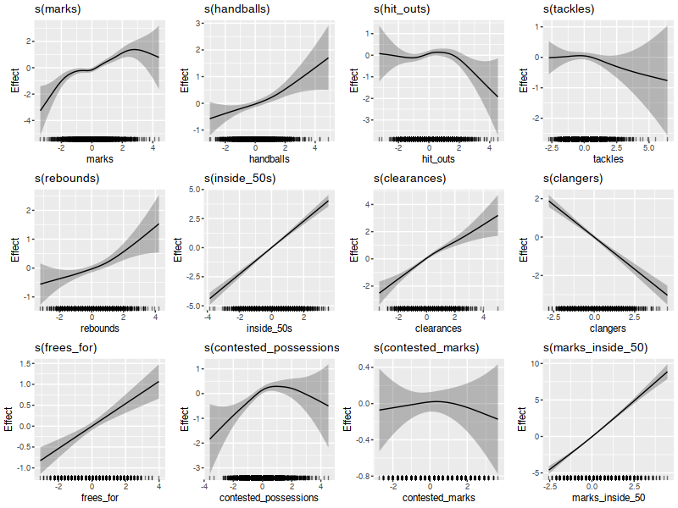
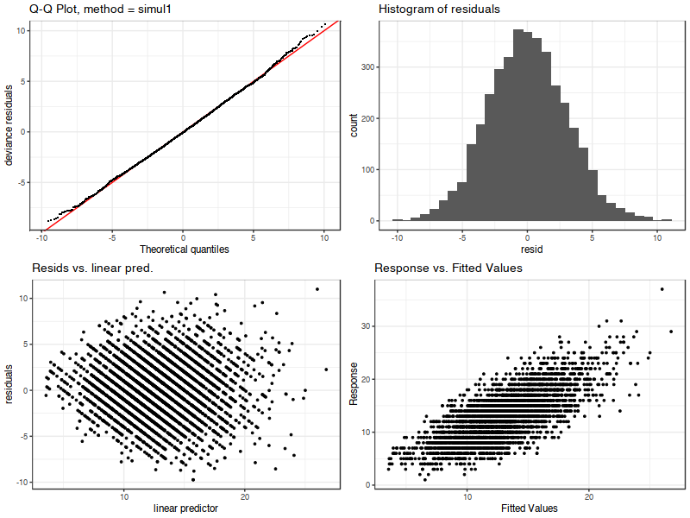
The analysis was taken further using GAMs

Slide 12
A set of implications and limitations were noted
Implications for AFL teams
Teams should understand their potential to generate opportunities and marks inside 50
Teams should develop strong strategies for producing efficient and effective clearances
Teams should be wary of negative coefficients and a causal interpretation
Tackling less doesn’t necessarily lead to higher scores. The negative relationship may indicate teams who score more are either more defensively efficient or simply spend more time attacking
Limitations and remediations
Not all variables in the available dataset were explored
Prior knowledge was used to select a subset of interest. Future research should examine all variables through a variable selection lens
The accuracy of the available datasets is likely very high, but there is no confirmation
It remains unclear whether an ordinary least squares approach is optimal
A GAM yielded superior model fit at a lower AIC and the OLS model displayed issues
Points scored is an integer count and may be better modelled through Poisson or Negative Binomial generalised linear models

Slide 13
Questions?

Slide 14
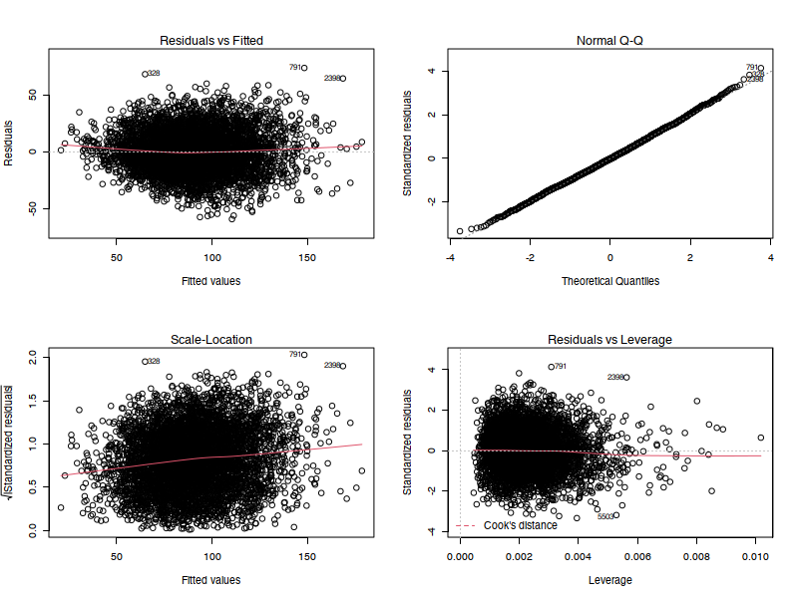
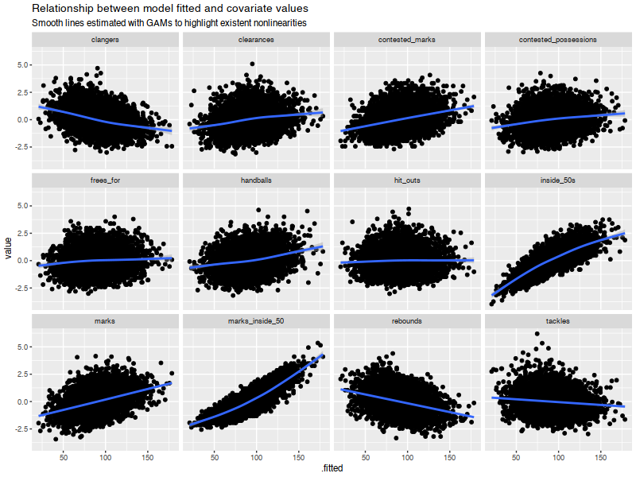
Supporting content

